Slide 1
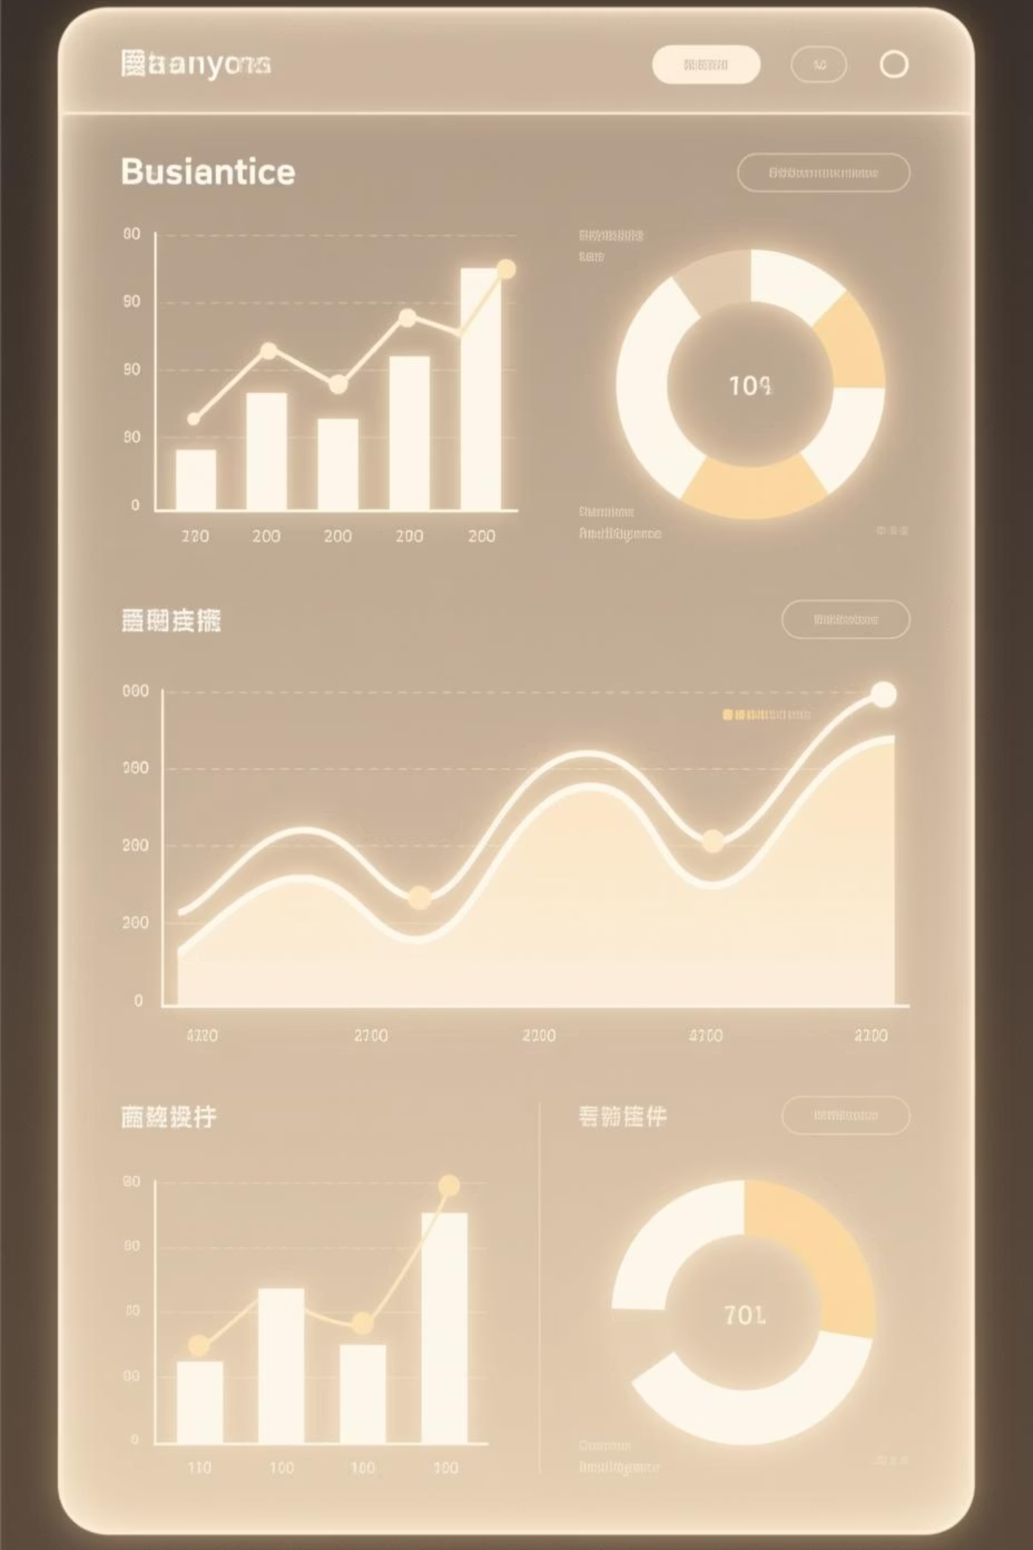
Customer Purchase Behavior & Revenue Insights
End-to-End Data Engineering & Analytics Project

Slide 2

Project Objective
Built a full-stack data analytics solution analyzing 3,900 e-commerce transactions to drive data-informed business strategy.
Tech Stack
Python (pandas, numpy)
Focus Areas
PostgreSQL
Customer segmentation (RFM analysis)
Power BI
Revenue optimization
ETL pipelines
Discount impact analysis
Subscription behavior modeling

Slide 3
Dataset Overview
3.9K
18
1%
Transactions
Columns
Missing Data
Comprehensive customer purchase data
Customer, product, behavioral attributes
Review Rating only
Demographics
Transactional
Behavioral
Age, Gender
Purchase Amount
Discount Applied
Location
Item, Category
Previous Purchases
Subscription Status
Size, Color, Season
Review Rating

Slide 4




ETL Pipeline Architecture
Extract & Load
Transform
Load
Ingested CSV into pandas
Data profiling & cleaning
Dimensional model design
Connected to PostgreSQL
Median imputation for nulls
Fact & dimension tables
Loaded to staging schema
Schema standardization
Bulk insert optimization

Slide 5
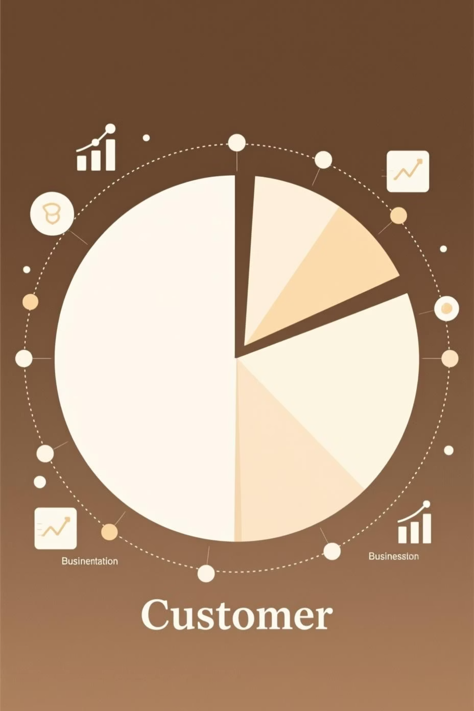
Feature Engineering
Critical transformations for segmentation & modeling
1
2
Age Binning
Purchase Frequency
Created age_group: Teen, Young Adult, Adult, Senior
Derived days_since_last_purchase and frequency categories
3
Customer Segmentation
New: 1 purchase
Returning: 2–5 purchases
Loyal: >5 purchases

Slide 6
Advanced SQL Analytics
Complex queries using CTEs, window functions, and aggregations
Business Question
SQL Techniques
Key Insight
Revenue by Gender
GROUP BY, SUM()
Females: 56% of revenue
High-value discount users
HAVING, subqueries
142 customers spent > avg
Top rated products
AVG(), ORDER BY
Blouse: 4.8/5 rating
Shipping impact on AOV
GROUP BY shipping_type
Express: 28% higher AOV
Subscriber performance
Window functions, CTEs
Subscribers: 3.2× higher LTV
Top products per category
ROW_NUMBER() PARTITION BY
Hero products identified

Slide 7
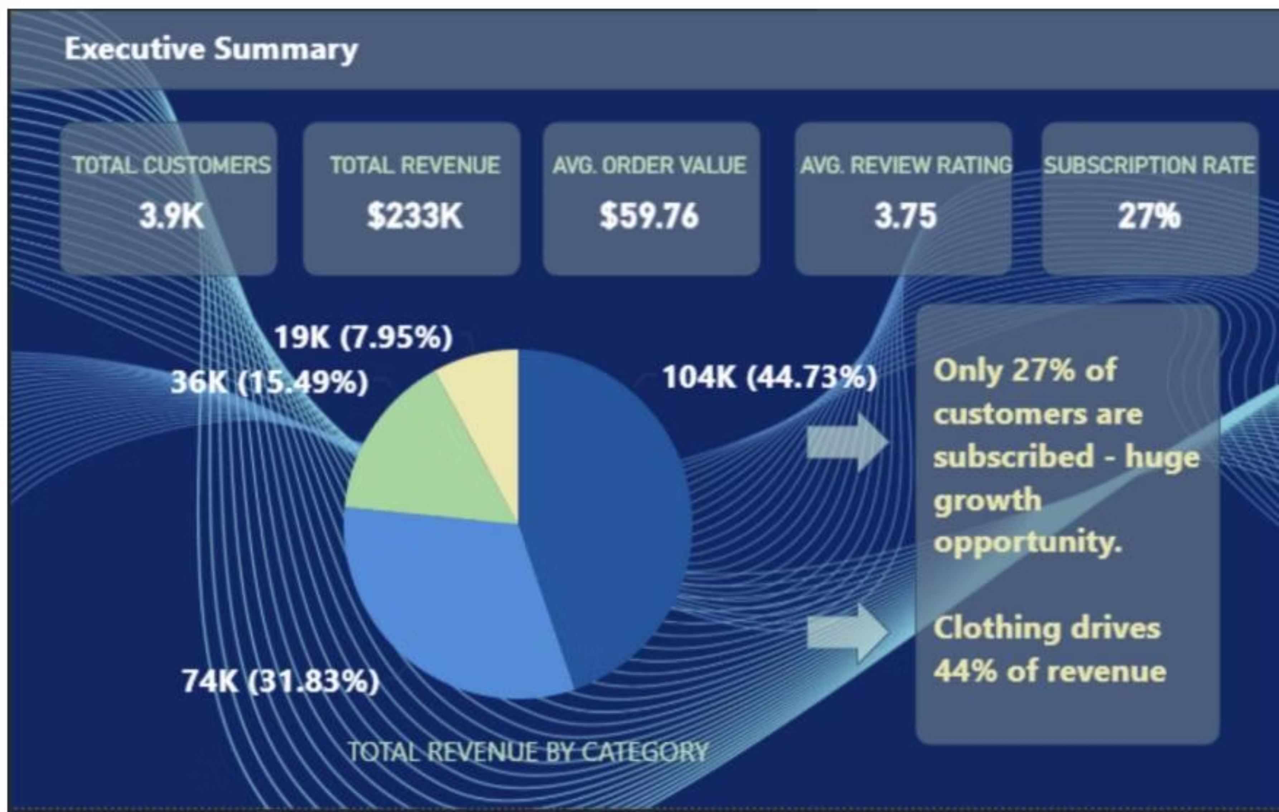

Power BI Dashboard
Executive Summary
3.9K
$233K
$59.76
3.75
Total Customers
Total Revenue
Avg Order Value
Avg Review Rating
27%
Subscription Rate
Revenue by Category
Key Opportunity: Only 27% subscribed — huge growth potential
Clothing: 44.73% ($104K)
Accessories: 31.83% ($74K)
Footwear: 15.49% ($36K)
Outerwear: 7.95% ($19K)

Slide 8


Critical Business Insights
Subscription Opportunity
Discount Concentration
Customers with >5 purchases are 4× more likely to subscribe
18% of products drive 70% of discounted purchases
78% conversion rate for repeat buyers
5 products: >70% discount dependency
High-Value Segments
35–50 age group: 44% of revenue
Female customers: 56% of revenue

Slide 9
Data-Driven Recommendations
01
02
03
Prioritize Loyalty Incentives
Optimize Discount Strategy
Focus Marketing Budget
Target customers with >5 purchases for subscription conversion
Review margin impact on high-discount products
Target 35–50 age group and female customers (highest ROI)
04
05
Promote Top-Rated Items
Upsell Express Shipping
Feature Blouse, Jewelry via hero banners and email campaigns
Push to high-AOV customers (28% higher value)

Slide 10

Technical Skills Demonstrated
Data Modeling
ETL Pipeline Design
Star Schema in PostgreSQL
Extract → Transform → Load
Advanced SQL
Window functions, CTEs
Data Cleaning
Business Intelligence
Imputation strategies
Power BI + DAX measures
Feature Engineering
RFM segmentation logic

